Slide 1
Portland State University and
Shandong University
Dual Degree 2+2 Program
美国波特兰州立大学商学院 同
中国山东大学经济学院合作
2+2 双学位项目
商业管理学院
波特兰州立大学

Slide 2
Introduction to Portland
波特兰市简介

Slide 3
Portland State University is located in the city of Portland, which is the largest city in the state of Oregon, and one of the four largest coastal-cities on the west coast of the US. It is beautiful, with spring-like weather all year around, and one of the safest cities in the USA.
波特兰州立大学位于波特兰市区内. 波特兰市是俄勒岗州最大的城市, 也是美国西部4个最大的港口城市之一, 波特兰市风景优美, 四季如春, 是美国最安全的城市之一.
Portland has a climate marked by both warm, dry summers and wet, cool-to-chilly winter days. It is known as the “City of Roses” and is one of the safest and top 3 best-living cities in the US.
波特兰的气候特点是夏季温暖干燥，冬季凉爽潮湿。它被称为“玫瑰之城”，是美国最安全和最适合居住的城市前三名之一。
The transportation system in the city is very convenient; the street car are available free of charge for students throughout the city center.
城市内的交通非常方便, 市内街道有轨车特兰州立大学学生可以免费乘坐.

Slide 4
Downtown Portland 波特兰市中心

Slide 5
Introduction to Portland State University
波特兰州立大学简介

Slide 6
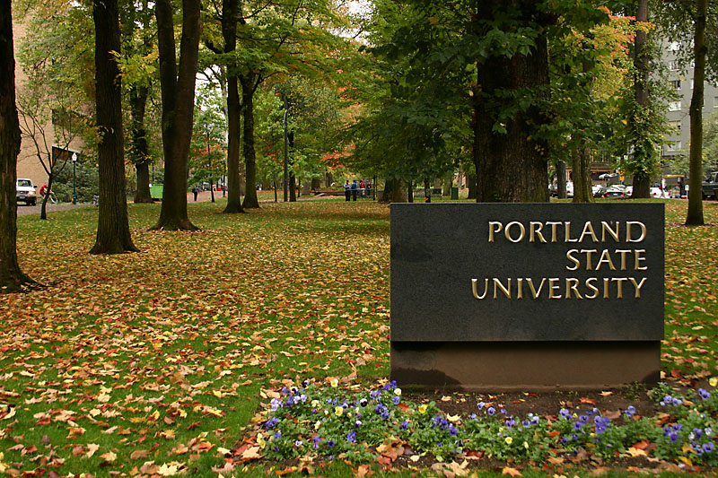
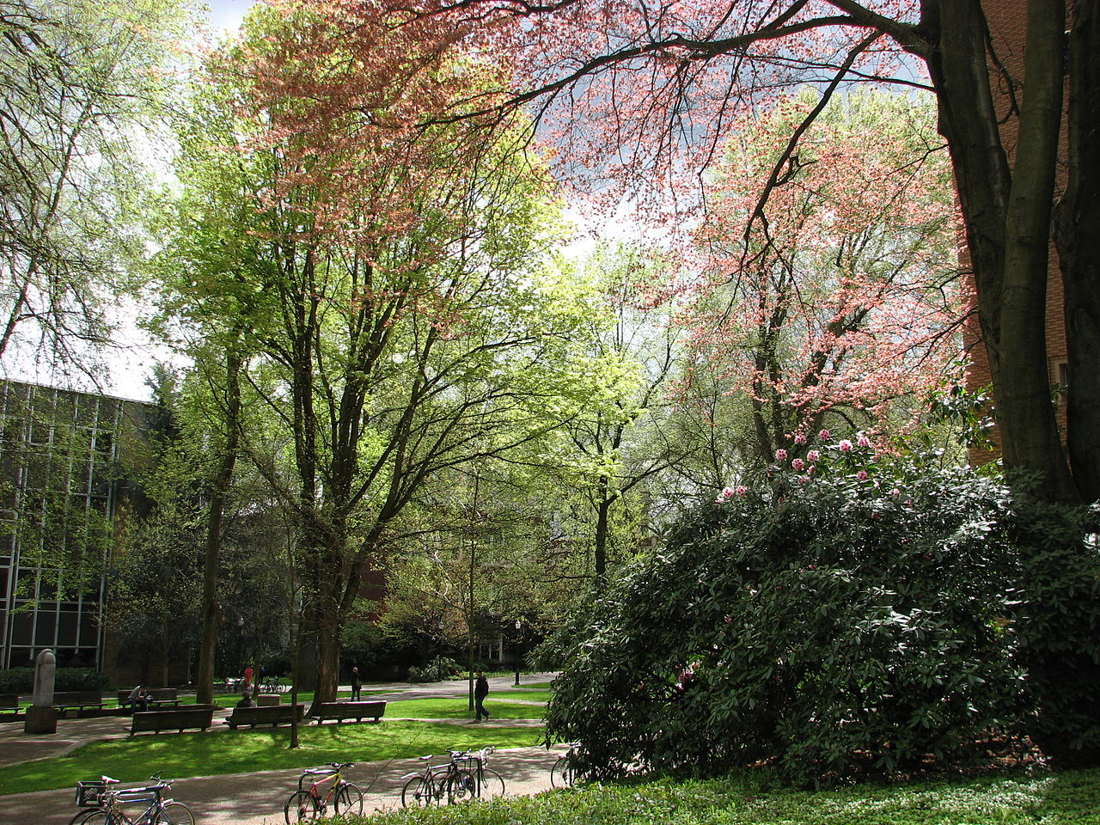
波特兰州立大学
Portland State University Campus
波特兰州立大学校园
South Park Blocks
南园

Slide 7
波特兰州立大学
Portland State University
波特兰州立大学
Portland State University (PSU) is located in downtown Portland, Oregon, United States. Founded in 1946, is the largest of the 7 public universities in the State of Oregon.
波特兰州立大学位于美国俄勒冈州波特兰市中心。建立于1946年，波特兰州立大学是美国联邦教育部及美国高等教育学分委员会体系中著名的大学之一.

Slide 8
波特兰州立大学
The university is a comprehensive university, offering more than 226 bachelor's, master's and doctoral degrees. The University has a total enrollment of over 29,818 students, including 22,706 undergraduate students, and 7,112 graduate students. Students enroll at PSU from every USA state. More than 2,000 students come from 100 different countries.
波特兰州立大学是一所综合型大学, 共有226个本科专业, 硕士专业和个博士专业.学生总数为29818名学生,其中包括22706名本科生，7112名研究生. 学生们来自美国给个州，大约2000名国际学生来自世界100多个国家。
Portland State University is fully accredited by the Northwest Commission on Colleges and Universities. The Carnegie Foundation also classifies PSU under the top schools for Curricular Engagement and Outreach Partnerships.
波特兰州立大学是美国教育委员认证的著名大学，教学体系是全美排名前列的大学之一.
Portland State University Campus: 50 acres, total Buildings: 50, student housing properties: 10
波特兰州立大学占地面积50亩，共有各种教学和办公楼 50个，校内学生宿舍10个

Slide 9
Introduction to School of Business Administration, Portland State University
波特兰州立大学商业管理学院简介

Slide 10
商业管理学院
波特兰州立大学
The School of Business Administration at Portland State University is the largest business school in the Pacific Northwest, with 3000 admitted undergraduate students and 700 graduate students. Courses are taught by a mix of 70 full time academically (Ph. D) and professionally qualified faculty.
波特兰州立大学商业管理学院是美国西北部最大的商业管理学院, 目前有3000名本科生，700名研究生，全职博士级教授和专业教学人员共计70多名。
The School of Business is accredited by AACSB. Only 5% of all business schools in the world have earned AACSB accreditation.
波特兰州立大学商学院是被国际商管学院促进协会（AACSB）认可的最好的商学院之一，世界上仅有5%的商业管理学院被AACSB认可。

Slide 11
商业管理学院
波特兰州立大学
The School of Business Administration's undergraduate program ranked by U.S. News & World Report as a "program to look for" based on its programs leading to student success.
波特兰州立大学商学院的本科生项目被美国权威机构<<美国新闻和世界报道>>评为是 "最受学生们欢迎的项目"，因为它可以指导学生们走向成功。
Reflective of the quality of the School overall, the MBA program is ranked top14th in the world by Beyond Grey Pinstripes.
波特兰州立大学的商业管理学院的MBA项目在《Beyond Grey Pinstripes》中被评为全世界前14名。
PSU’s Internet-based eMBA program was ranked in the top 5 in the US.
波特兰州立大学商学院的eMBA专业名列全美前5名.

Slide 12
商业管理学院
波特兰州立大学
Undergraduate Majors:
Accounting
Finance
Management & Leadership
Human Resource Management
Advertising Management
Supply & Logistics Management
Real Estate
Marketing
商学院本科专业项目：
会计
金融
管理和领导
人力资源管理
广告管理
物流与供应链管理
房地产
市场营销

Slide 13
Introduction to the 2+2 Dual Degree Program at the School of Business Administration, Portland State University
波特兰州立大学商业管理学院
2+2双学位项目简介

Slide 14
商业管理学院
波特兰州立大学
The 2+2 Dual Degree Program will provide an opportunity for Chinese undergraduate students from School of Economics, Shandong University (SDU) to study for two or more years at Portland State University (PSU), and upon successful completion of program requirements, receive a bachelor's degree from each institution.
参加2+2 双学位项目的山东大学经济学院的本科生将在美国波特兰州立大学学习2年，并成功的完成了本科学位所要求的学术要求后，将可以获得中国山东大学和美国波特兰州立大学两个学士学位。
Students in the Dual Degree Program will begin by enrolling in the bachelor‘s program in business and finance at SDU, and will follow the program of study established by SDU for two years. They will then travel to Portland for an estimated two years of study at PSU. The precise program length will depend upon the student's course preparation for the Business degree at PSU and the student's ability to successfully complete the PSU requirements for a bachelor's degree in a timely manner.
参加2+2双学位项目的学生将在中国山东大学经济学院的本科项目学习两年，然后到美国波特兰州立大学学习2年左右时间，学习时间的长短取决于学生在到达波特兰州立大学前的准备情况，以及学生本人的能力。

Slide 15
商业管理学院
波特兰州立大学
Under this 2+2 program, SDU students would complete 2 years in China and 2 years at PSU. Students completing this program, at their completion, would earn 2 degrees :
A Bachelors of Arts in Business from PSU
A Bachelors of Economics from SDU
按照2+2项目的安排，参加2+2项目的山东大学经济学院的学生将在山东大学学习2年，然后到美国波特兰州立大学学习2年，成功的完成本科学业后，将获得2个学士学位：
美国波特兰州立大学商业管理学士学位
中国山东大学经济学学士学位

Slide 16
商业管理学院
波特兰州立大学
Students accepted by PSU will come to Portland and enroll in PSU beginning in the fall Quarter. Students will take approximately 45 credits per year of undergraduate coursework in agreement with their degree objectives in consultation with their advisor in the School of Business, according to the following model:
Fall Quarter: 15 credits
Winter Quarter: 15 credits
Spring Quarter: 15 credits
2+2项目的学生将于秋季入学，入学后将在商学院指导老师的指导下，每年需要完成大约45学分的本科项目课程，以保证成功的完成学士学位所需要的全部课程。课程安排如下：
秋季： 15个学分
冬季： 15个学分
春季; 15个学分

Slide 17
商业管理学院
波特兰州立大学
Program Admission 项目录取：
SDU students desiring to enter the Dual Degree Program will apply for admission as transfer students into the B.S. program in Business Administration at PSU during Fall Term of their second year of study at SDU.
希望参加2+2项目的山东大学的学生将在进入山东大学学习的第二年，申请秋季入学的，作为转读生的波特兰州立大学商学院学士学位项目。
Students accepted by PSU must meet all regular and international admission criteria for undergraduate study in the School of Business during Fall Term of their second year of study at SDU. Admissions criteria include presenting evidence of satisfactory academic progress and a minimum TOEFL, IELTS, or PSU English Placement Exam score consistent with PSU and School of Business international admissions policies. Students are requested to pay US $50.00 non-refundable application fee.
被录取的学生必须达到波特兰州立大学国际学生录取的标准，录取标准包括学术成绩的要求和英语语言的要求。学生需缴纳50美元申请费。

Slide 18
商业管理学院
波特兰州立大学
A cumulative (overall) grade point average (GPA) of 2.25 (*as assessed by PSU’s International Evaluation Team) or better during in all of their undergraduate courses at SDU.
大学前两年在山东大学的成绩绩点GPA到达2.25,或者高于2.25 (成绩绩点由波特兰州立大学国际办公室的评估小组评估）。
An official TOEFL or IELTS Score.
TOEFL IBT 71, with a minimum of 15 in reading and writing,
or minimum 6.0 on the IELTS exam, with a minimum of 6.0 on reading and writing.
英语成绩： 托福总分71，阅读和写作15分；
雅思总分6.0，阅读和写作6.0以上。

Slide 19
商业管理学院
波特兰州立大学
Upon completion of their degree program at PSU, students may return to Shandong or they may apply to a graduate program at PSU or other universities.
学生们在波特兰州立大学完成学士学位后，可以回到山东，也可以申请波特兰州立大学或者美国其他大学的研究生项目。
While studying at the Portland State University, the students of 2+2 program can apply for the graduate programs in the US or UK universities. Business Management Core (BMC) program of the School of Business will give assistance on graduate school application strategy, GMAT and TOEFL preparation strategy, and counsel each student individually on the choice of schools, content of application package, and application strategy.
山东大学的学生在波特兰州立大学商学院2+2项目学习期间可以申请美国或者英国的各个大学经济，金融类的硕士学位研究生. 波特兰州立大学商学院BMC项目将给与学生全方位的帮助，帮助学生了解申请美国大学研究生项目的程序和策略, 成功的通过GMAT/GRE和TOEFL考试的策略, 并根据每个学生的具体情况给予个别的关于选择学校专业, 申请步骤, 和申请的策略方面的辅导.

Slide 20
商业管理学院
波特兰州立大学
Program Costs 项目费用：
At PSU, students enrolled in the PSU/SDU Dual program will pay PSU non-resident tuition and will be responsible for all regular PSU fees, including but not limited to: application fee, technology fee, differential tuition levels for courses offered by the School of Business, etc.
参加2+2项目的学生应按照波特兰州立大学商学院非居民学费和杂费标准支付学费，2013-2014年学杂费预计如下：
Estimated Tuition & Fees / Year 2013-2014年学杂费总计
Credits 学分 | Business Non-Resident Tuition 商学院非居民学费 | Mandatory Fees 杂费 | Health Insurance 保险费 | Total 总计
45 | $ 22,680 | $ 1,263 | $ 1,782 | $ 25,725
Total Tuition / Year |  | 每年学费 |  | $25,725
Total Tuition ( 2 Years) |  | 2年学费总计 |  | $51,450

Slide 21
商业管理学院
波特兰州立大学
Students who meet PSU's academic and language requirements and are recommended by SDU will qualify for an annual scholarship of $3,000.
达到波特兰州立大学学术和语言要求、并且被山东大学推荐的学生，将获得每年$3,000的奖学金。

Slide 22
商业管理学院
波特兰州立大学
The Benefits of 2+2 Program 2+2项目的优越性：
Time saving and lower cost, two bachelor's can be completed in 4 years.
节省时间，节省费用，4年中可以完成一个中国的学士学位和一个美国的学士学位。
Students who meet PSU's academic and language requirements and are recommended by SDU will qualify for an annual scholarship of $3,000.
被3+1+1项目录取的学生可以获得每年3000美元的奖学金。
Less cost, comparing with other business schools in the US, the tuition and living cost of the Portland State University is cheaper.
同美国其他大学的商学院相比较，波特兰州立大学商学院的学费和生活费用相对便宜很多。
Portland City is known as the “City of Roses” and is one of the safest and top 3 best-living cities in the US.
波特兰市被称为“玫瑰之城”，是美国最安全和最适合居住的城市前三名之一。

Slide 23
商业管理学院
波特兰州立大学
Business Management Core (BMC) Program Office will offer graduate admission consulting services for students seeking admission to US or UK graduate school. Under normal circumstances, Chinese students apply for the graduate schools in the US or UK, they usually use the Chinese middle agents to help them, which cost about RMB ¥30,000 to 50,000. But students in the 2+2 program will eliminates all these costs. Business Management Core (BMC) program at the School of Business will give assistance on graduate school application strategy, and counsel each student individually on the choice of schools, content of application package, and application strategy., it saves a lot of money and time.
商学院商业管理核心项目办公室将为2+2项目中希望申请美国或者英国研究生项目的学生提供全方位的咨询服务。在一般的情况下，中国学生申请美国或者英国的研究生项目，绝大部分学生是雇佣中国的中介公司帮助申请，一般要花费大约3万-5万的中介费用。而参加2+2项目的学生可以免去这些额外的费用，不需要去支付3万-5万人民币的中介费用，波特兰州立大学商学院BMC项目将给与学生全方位的帮助，帮助学生了解申请美国大学研究生项目的程序和策略, 并根据每个学生的具体情况给予个别的关于选择学校专业, 申请步骤, 和申请的策略方面的辅导.

Slide 24
波特兰州立大学
Welcome to School of Business Administration
Portland State University
波特兰州立商学院大学欢迎你！

